Slide 1






Shri Vishnu Engineering College for Women(A)::Bhimavaram
Department of Computer Science And Engineering
AUTI VOYAGE
Mini Project 2023-24
3rd CSE-C
Mentor : Dr.J.Veeraraghavan
P.Lavanya - 22B01A05E0
P.Ramya Sruthi - 22B01A05E2
R.Sai Jyothsna - 22B01A05F8
S.Naga Yasaswi - 22B01A05F9
Sk.Jabeen - 22B01A05G7

Slide 2





WHAT IS AUTISM?
In kids, autism can cause trouble with communication and social interaction, repetitive behaviors, intense interests, and sensitivity to sensory input. Each child with autism is unique, so these signs can vary widely in how they appear and affect daily life.
Notes:
WHAT IS AUTISM

Slide 3


Problems Faced By
Autistic Kids
Communication
Interaction
Repetitive Behaviour
Intense Interests
Adaptive Skills
Notes:
Problems Faced By Autistic Kids
Communication
Social Interaction
Repetitive behavior
Intense Interests

Slide 4
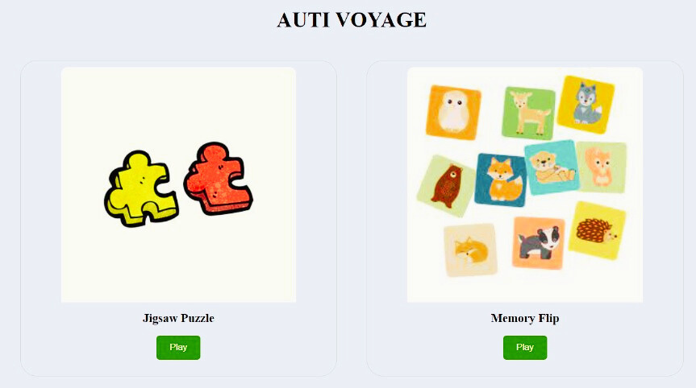
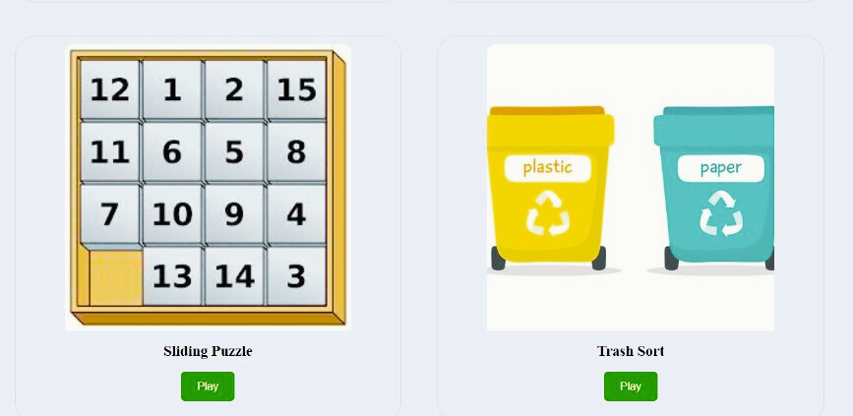


DESIGN
INCLUSION STARTS WITH UNDERSTANDING.

Slide 5

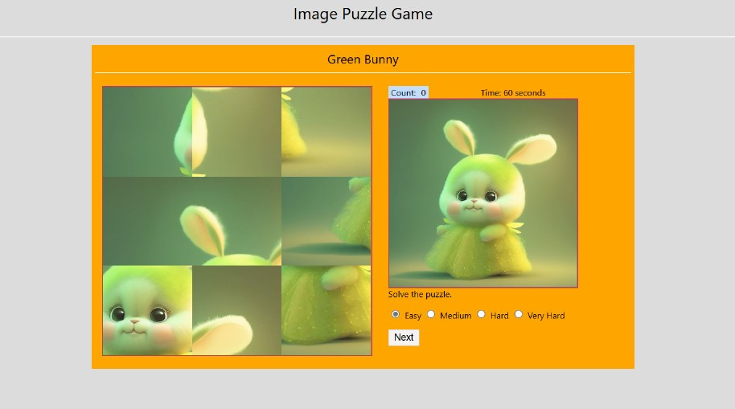

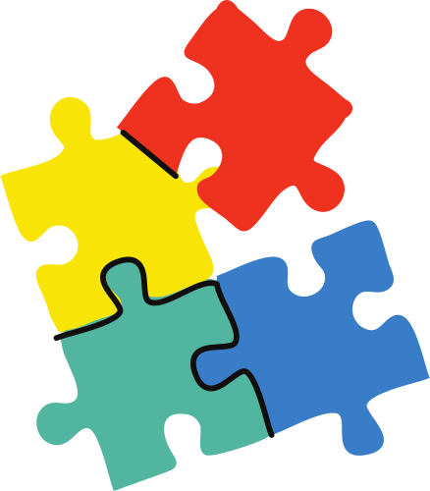
IMPLEMENTATION
JIGSAW PUZZLE
Jigsaw puzzles can be very beneficial for child with autism. They help improve fine motor skills and problem-solving abilities. The process of finding and fitting pieces together can also be calming and provide a sense of accomplishment.
Every autistic mind has its own brilliance.

Slide 6

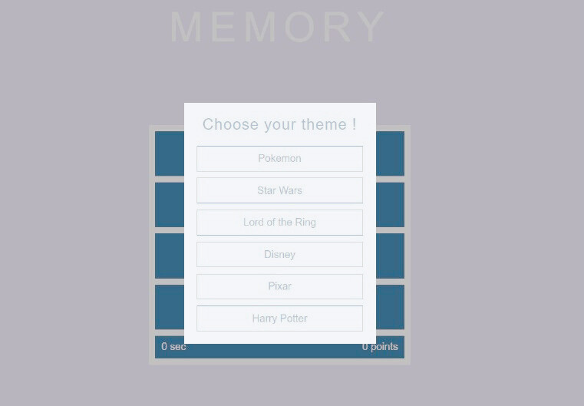


MEMORY FLIP
A memory flip game can be very helpful for child with autism. This game involves flipping over cards to find matching pairs, which can improve memory, attention, and concentration. It also helps with visual recognition and cognitive skills.
Uncovering the Unique in Every Brain

Slide 7

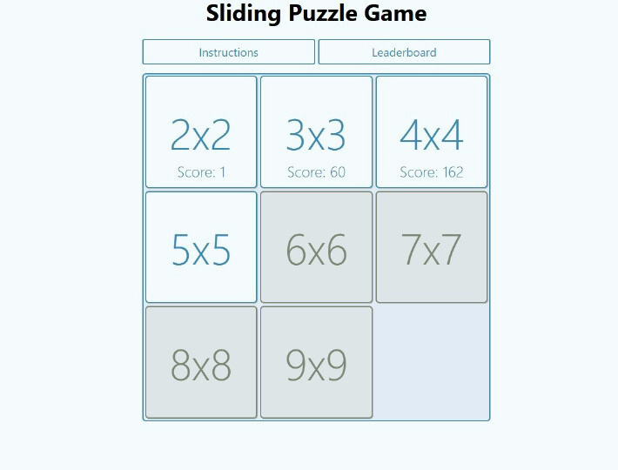


SLIDING PUZZLE
A sliding puzzle is a game where pieces are moved around within a frame to create a complete sequence. They help improve problem-solving skills.The process of figuring out how to move the pieces into the correct order can be challenging , providing a structured and engaging activity .
Every autistic mind has its own brilliance.

Slide 8
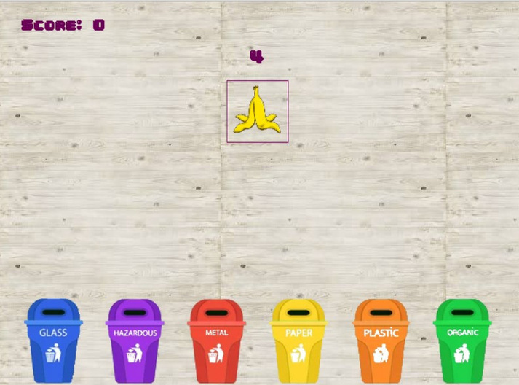


TRASH SORT
This game involves sorting items into the correct bins, such as glass, hazardous, plastic etc. It helps improve categorization skill and understanding of environmental concepts. The repetitive and structured nature of the game can be soothing.
Unique Abilities, Shared Dreams

Slide 9





TECHNOLOGIES
HTML
CSS
Java Script
Notes:
CSS
Java Script

Slide 10



CONCLUSION
Engaging individuals with autism through various games, such as jigsaw puzzles, memory flip games, sliding puzzles, and trash sorting games, can offer numerous developmental benefits like problem-solving, memory, attention, and categorization.

Slide 11



THANK YOU!

